Slide 1
FUNDAMENTALS OF MANAGEMENT + DECISION MAKING
BY DANIEL OBUOBI
UNIVERSITY OF CAPE COAST

Slide 2
Traditional Definition of Management
Attainment of organizational goals in an effective and efficient manner through:
Planning
Organizing
Leading
Controlling
and some authorities add:
Staffing

Slide 3
What is Management?
“The art of getting things done through people”
  [M. P. Follett, quoted in Daft 1993]

Slide 4
What is Management?
“The Manager’s job can be broadly defined as deciding what should
be done and getting other people
to do it.”
  [Rosemary Stewart quoted in Mullins 1999]

Slide 5
What is Management?
“[Management] involves people looking beyond themselves and exercising formal authority over the activities and performance of other people.”
  [Mullins 1999]

Slide 6
Is Management Art or Science?
The Science of Management
  Assumes that problems can be approached using rational, logical, objective, and systematic ways
  Requires technical, diagnostic, and decision-making skills and techniques to solve problems
The Art of Management
  Decisions are made and problems solved using a
  blend of intuition, experience, instinct, and
  personal insights
  Requires conceptual, communication, interpersonal, and time-management skills to accomplish the tasks associated with managerial activities

Slide 7
Key Concepts of Management
❶ The four functions of management
• Planning
• Organizing
• Leading
• Controlling
Sometimes a fifth is added:
• Staffing
❷ Attainment of organizational goals in an effective & efficient manner

Slide 8
Four Functions Defined
Planning
  Setting an organization’s goals and selecting a course of action from a set of alternatives to achieve them [Griffin 2003]
  Deciding in advance what to do, how to do it, when to do it, and who is to do it
Organizing
  Determining how activities and resources are grouped [Griffin 2003]
  Determining the composition of work groups and the way in which work and activities are to be coordinated

Slide 9
Four Functions Defined
Leading
  The set of processes used to get organizational members to work together to advance the interests of the organization [Griffin 2003]
  Motivating and communicating with the organization’s human resources to ensure goals are attained

Slide 10
Four Functions Defined
Controlling
  Monitoring organizational progress towards goals [Griffin 2003]
  The process of comparing results and expectations and making the appropriate changes
And that pesky fifth one: Staffing
  The recruitment, selection, assignment, training, development, evaluation and compensation of staff

Slide 11
What Do We Mean By…
Effectiveness?
  The degree to which goals are achieved
  Making the right decisions and successfully implementing them
  Doing the right things in the right way at the
  right times
Efficiency?
  Using minimal resources to produce the desired volume of output
  Using resources wisely and in a cost-effective way
  Operating in such a way that resources are not wasted

Slide 12
And What is an Organization?
A social entity that is:
  goal directed
    designed to achieve some outcome
  deliberately structured
    tasks are divided and responsibility for their performance is assigned
  [Daft 1993]
Concept from the behavioral viewpoint of management
(alternative to systems viewpoint)

Slide 13
An Alternative Definition
An organization
  involves the interactions and efforts of People
  in order to achieve Objectives
  channelled and coordinated through Structure
  directed and controlled via Management
    [Mullins 1996]

Slide 14
Models of Management
Planning
Select goals and ways to attain them
Resources
Performance
Human
Financial
Raw Materials
Technological
Information
Organizing
Attain goals
Products
Services
Efficiency
Effectiveness
Controlling
Monitor activities and make corrections
Assign responsibility for task accomplishment
Leading
Use influence to motivate employees

Slide 15
Systems Approach
Systems Approach theorists believe that
effectiveness is attained through:
  planning
  programming
  monitoring
  measuring
  controlling
  specialization of function
  clear job definitions
  standard procedures
  clear lines of authority

Slide 16
Models of Management
Systems Model of Management
environment
environment
Inputs
Transformation
(process through
management
functions)
Outputs
output from
other systems
output to
other systems
Inputs
Outputs
aims &
organizational
objectives
organizational
goals & output
Feedback (Measure of Achievement)

Slide 17
Systems Approach Examples
Military & government agencies
Traditional major industrial production (automobiles, etc.)
Some service firms (insurance,banking)

Slide 18
Behavioral Approach
Behavioral Approach theorists believe that effectiveness is attained through:
  decreased control
  greater autonomy for people
  encouragement of innovation
  creativity

Slide 19
Behavioral Approach Examples
Ad agencies
Design firms
Most dotcoms
Software development

Slide 20
Integrated Management Perspectives
Systems Approach
Contingency Perspective
•
Recognition
of internal
•
Recognition
of the situational
interdependencies
nature of management
•
Recognition of
•
Response to particular
environmental influences
characteristics of situation
Classical
Behavioral
Quantitative
Management
Management
Management
Perspectives
Perspectives
Perspectives
Methods for
Insights for moti-
Techniques for
enhancing
vating performance
improving decision
efficiency and
and understanding
making, resource
facilitating planning,
individual behavior,
allocation, and
organizing, and
groups and teams,
operations
controlling
and leadership
Effective and efficient management
SOURCE: Adapted from Fundamentals of Management, Griffin, R. W. , Houghton Mifflin 2003

Slide 21
What is a Manager?
Someone whose primary responsibility is to carry out the management process
Someone who plans and makes decisions, organizes, leads, and controls human, financial, physical, and information resources
  [Griffin 2003]

Slide 22
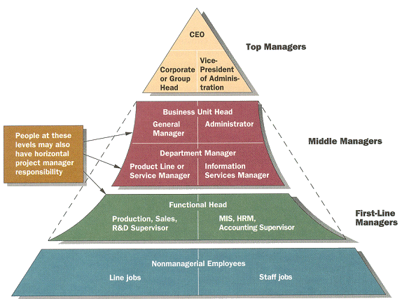
Management Levels (typical)
/CIO
CTO
SOURCE: Adapted from Thomas V. Bonoma and Joseph C. Lawler, “Chutes and Ladders: Growing the General Manager,” Sloan Management Review (Spring 1989), 27-37.

Slide 23
Management Levels Defined
First line Managers
  directly responsible for day-to-day operations
  supervise and coordinate the activities of operating employees
Middle Managers
  work in the middle levels of the organization
  responsible for sections or departments
  supervise and coordinate the activities of
  lower-level managers
  responsible for implementing the policies and plans of top managers

Slide 24
Management Levels Defined
Top (or Senior) Managers
  usually form a team
  manage the organization’s overall goals, strategy, and operating policies
  responsible for the entire enterprise
Middle and top managers may also be:
  Functional Managers
    responsible for a distinct function in the enterprise

Slide 25
Horizontal Differences
Functional managers
  Responsible for departments that perform a single functional task
General managers
  Responsible for several departments that perform different functions

Slide 26
Managers by Area
Marketing Managers
  Work in areas related to getting consumers and clients to buy the organization’s products or services
Financial Managers
  Deal primarily with an organization’s financial resources
  Typically supervise IT in small organizations (!)
Operations Managers
  Concerned with creating and managing the systems that create organization’s products and services
  May be IT managers in IT businesses (but even
  then are primarily focused on production)
  [Griffin 2003]

Slide 27
Manager by Area
Human Resource Managers
  Human resource planning, recruiting and selection, training and development, designing compensation and benefit systems, formulating performance appraisal systems
Administrative Managers
  Generalists familiar with all functional areas of management and who are not associated with any particular management specialty
Other Kinds of Managers
  Specialized managerial positions directly related to the needs of the organization
  May include IT management
  [Griffin 2003]

Slide 28
Key Managerial Roles
Informational
Interpersonal
Decisional
Monitor
Disseminator
Spokesperson
Positions the manager so as to facilitate the sending and receiving of information
Figurehead
Leader
Liaison
Involves the manager in relationships with other individuals both inside and outside the firm
Entrepreneur
Disturbance handler
Resource allocator
Negotiator
The manager uses the available information
to make important decisions
[Munsterberg]
SOURCE: Adapted from Van Fleet, David D., Contemporary Management, Second Edition, Houghton Mifflin 1991

Slide 29
Characteristics of Management
Managerial activities involve
  variety
  fragmentation
  brevity
  large volume of work performed quickly
To illustrate:
  First line managers in an industrial firm may average over 500 incidents a day [Handy 1995]
  In a study of 100 managers over four weeks, each of them had on average only nine periods of half an hour without interruption [Rosemary Stewart]

Slide 30

Management Skills
Management skills required
by management levels
Top Managers
Middle Managers
First-Line Managers
Non-managers (Personnel)
Conceptual Skills “People” Skills Technical Skills

Slide 31
Fundamental Management Skills
Technical
  Skills necessary to accomplish or understand the specific kind of work being done in an organization
Interpersonal
  Ability to communicate with, understand, and motivate both individuals and groups
Conceptual
  Ability to think in the abstract and to see the organization as a complete unit and to integrate and give direction to its diverse activities so that objectives are achieved
  [Griffin 2003]

Slide 32
Fundamental Management Skills
Diagnostic
  Ability to visualize the most appropriate response to a situation
Communication
  Abilities both to convey ideas and information effectively to others and to receive ideas and information effectively from others
Decision-Making
  Ability to recognize and define problems and opportunities correctly and then to select an appropriate course of action to solve the problems and capitalize on opportunities
  [Griffin 2003]

Slide 33
Fundamental Management Skills
Time-Management
  Ability to prioritize work, to work efficiently, and to delegate appropriately
  [Griffin 2003]

Slide 34
Current Management Issues
Acute labor shortages in high-technology job sectors and an oversupply of less skilled labor
Increasingly diverse and globalized workforce
Need to create challenging, motivating, and flexible work environments
Effects of information technology on how people work
  [Griffin 2003]

Slide 35
Current Management Issues
Complex array of new ways of structuring organizations
Increasing globalization of product and service markets
Renewed importance of ethics and social responsibility
Use of quality as the basis for competition
Shift to a predominately service-based economy [Griffin 2003]

Slide 36
The “New Workplace”:
Centered around information and ideas
Work is free-flowing and flexible
Work is often virtual

Slide 37
Today’s Managers…
Embrace ambiguity
Create organizations that are:
  Fast
  Flexible
  Adaptable
  Relationship-oriented
Focus on:
  Leadership
  Staying connected to employees and customers
  Team building
  Developing a learning organization

Slide 38
Parting Shot…
In the immortal words of John Wayne:
“Life is hard, but it’s harder
when you’re stupid.”

Slide 39
Parting Thought: Strategy is…
a pattern of decisions that integrates an organization’s major goals, policies, and operating procedures into a cohesive whole
a set of tools to marshal and allocate an organization’s resources into a unique and viable position based on its relative competencies and shortcomings, anticipated changes in the environment, and contingent moves by intelligent opponents
the other part of this course…

Slide 40
MANAGEMENT
An organization's success depends on
  managers, but also
  technical competence,
  adaptability to its environments, and
  a thorough knowledge of its product and production processes.
Success is not easy to come by. Why? Management :
  management of the employees,
  management of the product, and
  management of information.

Slide 41
THE THREE SCHOOLS OF MANAGEMENT
The three schools of management are
Technical-rational perspective (Classical)
  Basically views people as machines.
  The manager is also responsible for creating an administration that keeps the machine well-oiled and fixes any broken parts.
Behavioral, and
  There are many more factors to take into consideration when managing humans rather than machines. Takes these factors into account.
Cognitive
  evolved in and from the computer revolution of the last few decades as information systems proliferated and improved
  Says an organization must create and use information to its utmost advantage. The organization must gather, create, store, disseminate, and use information and knowledge

Slide 42
CLASSICAL THEORY
Henri Fayol's classic theory of management says managers perform five distinct functions:
  Planning
  Organizing
  Coordinating
  Deciding
  Controlling
In order to fulfill each of these functions, a manager must communicate to people in the organization. (Plans, ideas)
  The people a manager communicates with, regardless of the action, are all around him/her.
  They could be at a lower or higher management level, inside or outside the organization.
The role of Info Sys. is to improve the mechanical operation of the organization.

Slide 43
THE BEHAVIOR THEORY
This management theory gives you insight into the use of information systems to enhance the effectiveness of the organization.
It has had a powerful influence on the field of information systems:
  User acceptance literature emphasizes the sociological and psychological aspects of the system success.
  Strategic IS literature emphasizes the importance of responding to and dominating the environment.
  Network organization and virtual organization literature emphasizes organizing labor without traditional hierarchies.
The manager's role is to assist the organization in continually changing and adapting to its environment.

Slide 44
MANGERIAL ROLE
Mintzberg puts managerial roles into three categories:
Interpersonal. Managers act as representatives of the organization to internal and external audiences.
Informational. Managers pass information up and down and around the organization.
Decisional. Once managers make a decision, they must pass it on to someone else. But before they can make that decision, they have to gather information from internal/external sources.

Slide 45
COGNITIVE THEORY
The effective manager will make sense of the situation, help the organization act in its best interest, and create the proper infrastructure for information- and knowledge-processing to the advantage of the organization. .
The organization can get a better sense of its environment, internal & external, and how to create and use information through and from the Internet.
Some managers are more successful at this than others .
The successful manager:
  Creates knowledge structures by filtering information from the environment. Not every piece of information is worthwhile.
  Solves problems and makes decisions. If the manager is successful, then the organization triumphs.
  Processes information. The information may be internal or external.
  Creates information-processing structures, programs, and routines

Slide 46
KNOWLEDGE-BASED VIEW OF THE FIRM
Getting the best depends on the individual manager.
The knowledge-based view focuses on the organization's ability to gather, produce, maintain, and disseminate knowledge.
Some organizations require more intense information and knowledge gathering in order to produce their products and services than others.
Regardless of the management model followed, managers spend most of their time communicating: listening, talking, reading, writing.
The use of email technology allows managers to complete more communications than ever before.
They can also employ other methods of technology that increase the amount of communicating they do.

Slide 47
LEVELS OF DECISION MAKING
IS is related to the types of decisions managers make
Strategic Decision Making.
  These decisions are usually concerned with the major objectives and policies of the organization,
Management Control.
  These decisions affect the use of resources, and determine the performance of the operational units
Knowledge-Level Decision Making.
  These decisions determine new ideas or improvements to current products or services.
Operational control.
  These decisions determine specific tasks that support decisions made at the strategic or managerial levels.

Slide 48
TYPES OF DECISIONS
Structured or unstructured.
Structured decisions involve definite procedures and are not necessarily very complex.
The more unstructured a decision becomes, the more complex it becomes
Every level of the organization makes different types of decisions
It's easier to develop an IS to support structured decision than unstructured decision making

Slide 49
STAGES FOR DECISION MAKING
Decision-making process follows the same stages of development and implementation (whether by sudden, impulsive, slow or deliberate). The stages involved are:
  Intelligence. Identify the facts. Intuitively understand what the problem is and the effect it's having on you.
  Design. Design possible solutions
  Choice. Gather data that helps you make a better decision
  Implementation. Implement the decision
  Feedback. Gather feedback

Slide 50
Information Systems help improve the decision-making process by
providing more information about the problem
presenting a greater variety of possible alternatives
showing consequences and effects of choices
measuring the outcome of different possible solutions
providing feedback on the decision that is made

Slide 51
INDIVIDUAL MODELS OF DECISION MAKING
Humans make decisions based on experience and in very distinct ways based on their frame of reference
The rational model of human behavior says that
  People will evaluate the situation & determine what they want
  They will determine the alternative courses of action, know the consequences of each course, and then decide. Not easy anyway.
Bounded rationality
  sometimes people will follow the rational model to a certain extent, with a lot of compromising throughout the decision-making process, by using bounded rationality.
  That is, they will look at several alternatives,
  briefly evaluate the consequences of the alternatives, and then pick the solution that will get them closest to where they want to be (satisficing). If they've experienced a similar situation, they'll probably go with the decision most like the previous decision

Slide 52
INDIVIDUAL MODELS OF DECISION MAKING
Muddling Through
  Compromise is a very common occurrence in decision-making. Sometimes through discussion a final agreement is reached. You muddled through the decision-making process until everyone agreed on the solution.
The cognitive style theory
  supports the idea that people make decisions based on their experiences and values.
  It's one of the best explanations for why people make decisions the way they do

Slide 53
ORGANISATIONAL MODEL FOR DECISION MAKING
Bureaucratic Models
  The main goal of an organization is the preservation of the organization itself.
  Change is very slow and difficult because the structure isn't designed for change. Change is sometimes painful.
  Change causes uncertainty, and this type of organization isn't strong on changing anything
  Change is difficult because most use SOPs (Standard Operating Procedures) to determine how tasks will be accomplished.
  SOPs are usually based on previous decisions and work habits
  Changing the SOPs is to say that the previous methods were inferior or wrong. ( to some people)

Slide 54
ORGANISATIONAL MODEL FOR DECISION MAKING
Political Model
  Based not necessarily on what's good for the organization, but on what's good for the players involved.
  Compromise is more the norm than clear-cut decisions.
  The goal of this type of organization is to blend the interests of the players into a decision that satisfies as many people or entities as possible.

Slide 55
ORGANISATIONAL MODEL FOR DECISION MAKING
Garbage can model
  Too often the people involved in this type of decision making process develop the wrong answer to the wrong question.
  Any success is purely accidental.

Slide 56
HOW IS/IT HAS CHANGED MANAGEMENT PROCESS
Traditional and Contemporary Management
  IT has helped speed the change in methods
  Technology has enabled companies to flatten their hierarchies ( no extra layers)
  Managers and employees can work more efficiently and effectively by increasing the amount of information available to all employees.
  Communications are faster and more widespread and this enable employees & managers to collaborate more and work better in teams.
  Enable virtual organizations

Slide 57
IMPLICATION FOR SYSTEM DESIGN
The decision-making process is much different in today's than before.
It is dangerous to build a system to accommodate today's process without taking this into account.
  Understanding how people and organizations make decisions will help build a system that can accommodate the organization and the employees.
  IS should be created not only for decisions making, but also help them better communicate between all levels and units of the organization.
  Decisions affect a wide range of people, and the system should accommodate this fact.
  Managers should study all the data, all the possible outcomes and the alternatives when making the decision to change suppliers

Slide 58
Information systems characteristics
They are flexible and provide many options for handling data and evaluating information.
They are capable of supporting a variety of styles, skills, and knowledge.
They are powerful in the sense of having multiple analytical and intuitive models for the evaluation of data and the ability to keep track of many alternatives and consequences.
They reflect the bureaucratic and political requirements of systems.
They reflect an appreciation of the limits of organizational change and an awareness of what information systems can and cannot do.

Slide 59
ENCHANCING DECISION MAKING FOR DIGITAL FIRM
Laudon & Laudon
PowerPoint by Daniel Obuobi

Slide 60
Decision Making and Decision-Support Systems (DDS)
Because of the importance of high-quality decision making, firms are investing heavily in business intelligence systems, which consist of technologies and applications designed to help users make better business decisions.
The major applications and technologies used for business intelligence include supply chain management, customer relationship management, and enterprise systems; systems for knowledge management; and technologies such as data mining and online analytical processing (OLAP)

Slide 61
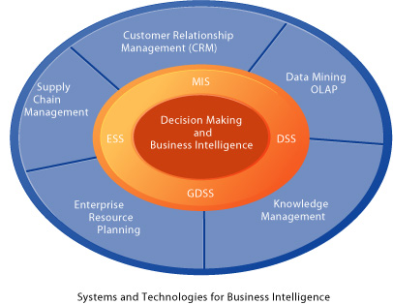
FIGURE 13-1 Systems and technologies for business intelligence
Each of the major enterprise applications provides support for decision making or “business intelligence” at all levels of the firm in addition to processing daily transactions.
Specialized systems such as MIS, DSS, and ESS described in this chapter work with these systems and technologies for data mining and online analytical processing (OLAP) to focus on the specific decision needs of managers and employees.

Slide 62
DECISION MAKING LEVELS
Decisions are made at all levels of the firm. Some decisions are very common and routine, but exceptionally valuable.
Although the value of improving any single one of these decisions may be small, improving hundreds of thousands of these small decisions adds up to a large annual value.
There are four different decision-making constituencies in a firm:
(1) senior management;
(2) middle management and project teams;
(3) operational management and project teams; and (4) individual employees.

Slide 63
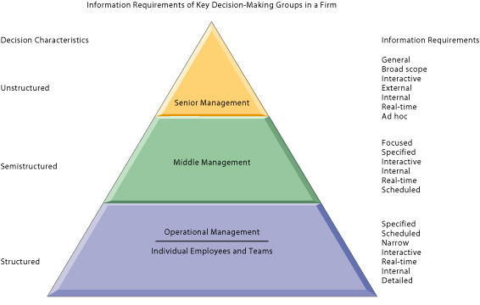
FIGURE 13-2 Information requirements of key decision-making groups
Various levels of management in the firm have differing information requirements for decision support because of their different job responsibilities and the nature of the decisions made at each level.

Slide 64
There are different types of decision-making at different levels. Decisions can be classified as structured, semistructured, and unstructured. Unstructured decisions are those in which the decision maker must provide judgment, evaluation, and insights into the problem definition. Structured decisions, by contrast, are repetitive and routine, and decision makers can follow a definite procedure for handling them to be efficient. Semistructured decisions are those in which only part of the problem has a clear-cut answer provided by an accepted procedure. In general, structured decisions are more prevalent at lower organizational levels, and unstructured decision making is more common at higher levels.
There are four kinds of systems used to support the different levels and types of decisions: Management Information systems (MIS), decision-support systems (DSS); executive support systems (ESS); and group decision-support systems (GDSS).
There are four different stages in decision making: intelligence, design, choice, and implementation. Intelligence consists of identifying and understanding a problem; design involves exploring various solutions; choice consists of choosing among available solutions; and implementation involves making the chosen alternative work and monitoring how the solution is working.

Slide 65
TYPES OF DECISIONS
There are different types of decision-making at different levels.
Decisions can be classified as structured, semistructured, and unstructured.
  Unstructured decisions are those in which the decision maker must provide judgment, evaluation, and insights into the problem definition.
  Structured decisions, by contrast, are repetitive and routine, and decision makers can follow a definite procedure for handling them to be efficient.
  Semistructured decisions are those in which only part of the problem has a clear-cut answer provided by an accepted procedure.
In general, structured decisions are more prevalent at lower organizational levels, and unstructured decision making is more common at higher levels.

Slide 66
SYSTEMS FOR DECISION SUPPORT
There are four kinds of systems used to support the different levels and types of decisions:
  Management Information systems (MIS),
  decision-support systems (DSS);
  executive support systems (ESS);
  and group decision-support systems (GDSS).

Slide 67
STAGES IN DECISION-MAKING PROCESS
There are four different stages in decision making: intelligence, design, choice, and implementation.
  Intelligence consists of identifying and understanding a problem;
  design involves exploring various solutions;
  choice consists of choosing among available solutions;
  and implementation involves making the chosen alternative work and monitoring how the solution is working.

Slide 68
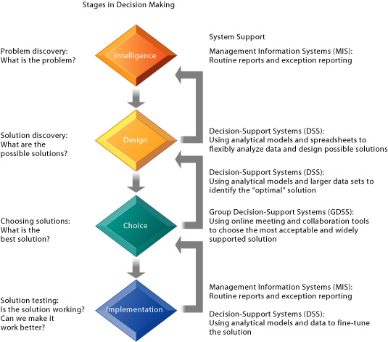
FIGURE 13-3 Stages in decision making
The decision-making process can be described in four steps that follow one another in a logical order.
In reality, decision makers frequently circle back to reconsider the previous stages and through a process of iteration eventually arrive at a solution that is workable.

Slide 69
DECISION MAKING IN REAL WORLD
For some firms, investments in decision-support systems do not always work out successfully for three reasons:
  Data/information quality,
  management filters, and
  organizational culture.
Data/Information Quality
  High-quality decisions require high-quality information regardless of information systems.
  There are seven dimensions of information quality when designing decision-support systems:
    Accuracy, integrity, consistency, completeness, validity, timeliness, and accessibility.

Slide 70
DECISION MAKING IN REAL WORLD
Management Filters
  Even with timely, accurate information, some managers make bad decisions.
  Managers filter by turning off information they do not want to hear because it does not conform to their prior conceptions.
Organisational Inertia
  Additionally, organizations are bureaucracies with limited capabilities and competencies for acting decisively.
  When environments change and new business models should be followed, strong forces within organizations resist making decisions calling for major change.

Slide 71
TRENDS IN DSS APPLICATIONS & BUSINESS INTELLIGENCE
There are six major trends in decision-support applications:
  (1) the production of detailed, enterprise-wide data;
  (2) the broadening of decision rights and responsibilities;
  (3) the use of intranets and portals;
  (4) the personalization and customization of information;
  (5) the use of extranets and collaborative commerce; and
  (6) the use of Web-based team support tools.

Slide 72
Systems for Decision Support
The difference between MIS and DSS
  Whereas MIS primarily address structured problems, DSS support semistructured and unstructured problem analysis.
  An MIS provides managers with reports based on routine flows of data and assists in the general control of the business, whereas a DSS emphasizes change, flexibility, and a rapid response.
  With a DSS there is less of an effort to link users to structured information flows and a correspondingly greater emphasis on models, assumptions, ad hoc queries, and display graphics.

Slide 73
TYPES OF DECISION SUPPORT SYSTEMS
A decision support system (DSS) is an interactive, user-friendly management-level computer system that combines data and sophisticated analytical models and tools to support semi-structured and unstructured decision making.
A DSS does not make decisions; rather it is a powerful tool that is used to support decision-making.
There are two basic types of DSS:
  data-driven DSS and
  model-driven DSS.
The earliest DSS were model-driven DSS, which were primarily stand-alone systems that used some type of model to perform "what-if" and other kinds of analyses.

Slide 74
DATA_DRIVEN DSS
Data-driven DSS support decision making by allowing users to extract data from large databases, which are often in corporate data warehouses.
Online analytical processing (OLAP) and datamining can then be used to analyze the data.

Slide 75
DATA MINING
Data mining provides insights into corporate data that cannot be obtained using OLAP by finding hidden patterns and relationships in large databases and inferring rules form then to predict future behavior.
The types of information that result from data mining include
  associations,
  sequences,
  classifications,
  clusters, and
  forecasts.

Slide 76
COMPONENTS OF DSS
The components of a DSS are the DSS database, the DSS software system with models and analytical tools, and the user interface.
The DSS database is a collection of data from a number of applications or groups.
The DSS software system contains the software tools that are used for analyzing the data, including OLAP tools, datamining tools, or a collection of mathematical or analytical models.
The user interface controls the interaction between the users of the system and the DSS software tools.

Slide 77
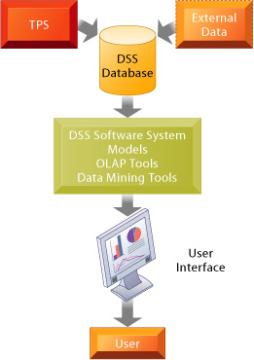
FIGURE 13-4 Overview of a decision-support system
The main components of the DSS are the DSS database, the DSS software system, and the user interface. The DSS database may be a small database residing on a PC or a massive data warehouse. and milk.

Slide 78
MODELS IN DSS
A model is an abstract representation that illustrate the components or relationship of a phenomenon.
A model can be
  Physical (model airplane)
  Mathematical (equation) or
  Verbal (description)
Each DSS is built for a specific set of purposes and makes different collections of models available depending on those purposes.

Slide 79
MODELS IN DSS
Most commonly used models are libraries of statistical model, optimization tools and forecasting tools.
Among the most widely used models are sensitivity analysis models that ask "what-if" questions to determine the impact of changes in one or more factors.
For example, sensitivity analysis might be used to analyze what would happen to revenues if the company raised prices by 5, 10, or 15 percent.
Backward sensitivity analysis software is used for goal seeking: If I want to sell 1 million product units next year, how much must I reduce the price of the product?

Slide 80
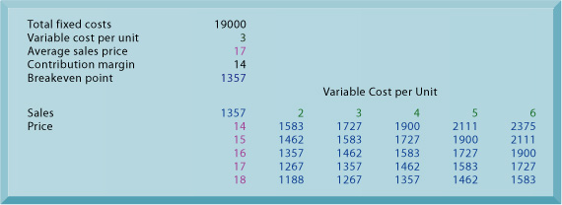
FIGURE 13-5 Sensitivity analysis
This table displays the results of a sensitivity analysis of the effect of changing the sales price of a necktie and the cost per unit on the product’s breakeven point. It answers the question, “What happens to the break-even point if the sales price and the cost to make each unit increase or decrease?”

Slide 81
BUSINESS VALUE OF DSS
Both data-driven and model-driven DSS have become very powerful and sophisticated, providing fine-grained information for decisions that enable the firm to coordinate both internal and external business processes much more precisely.
Some of these DSS are helping companies with decisions in supply chain management or customer relationship management.
Some take advantage of the company-wide data provided by enterprise systems.
DSS today harnesses the interactive capabilities of the Web to provide decision-support tools to both employees and customers.

Slide 82
BUSINESS VALUE OF DSS
Model-driven DSS help firms model alternative inventory stocking levels, production schedules, or transportation plans,
  and data-driven DSS provide firms with information on key performance indicators such as lead time, cycle time, inventory turns, or total supply chain costs.
DSS are used for customer relationship management, consolidating customer information from a variety of systems into massive data warehouses
  and then using analytical tools to slice data into tiny segments for one-to-one marketing and predictive analysis.
Predictive analysis uses data-mining techniques, historical data, and assumptions about future conditions to predict outcomes of events such as the probability a customer will respond to an offer or purchase a specific product

Slide 83
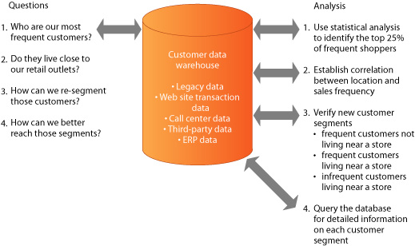
FIGURE 13-6 A DSS for customer analysis and segmentation
This DSS enables companies to segment their customer database with a high level of precision where it can be used to drive a marketing campaign. Based on the results of data mining, a firm can develop specific marketing campaigns for each customer segment. For example, it could target frequent customers living near a store with coupons for products of interest and with rewards for frequent shoppers.

Slide 84
DATA VISUALIZATION & GIS
By presenting data in graphical form, the data visualization tools of DSS help users see patterns and relationships in large amounts of data that would be difficult to discern if the data were presented as lists of text and figures.
Interactive visualizatoin tools enable users to manipulate data and see the graphical displays change in response to the changes they make.
Geographic information systems (GIS) are a category of DSS that use data visualization technology to analyze and display data in the form of digitized maps.
The software is used to manipulate and display geographically referenced information, tying data to points, lines, and areas on a map.
GIS is used to support decisions that require knowledge about the geographic distribution of people or other resources in scientific research, resource management, and development planning.

Slide 85
Web-based Customer DSS
Internet-enabled DSS support decision making by providing online access to databases and information pools along with software for data analysis.
Some of these DSS are targeted toward management, but many customer decision-support systems (CDSS) have been developed to attract customers by providing information and tools to assist their decision making.
Some companies have developed specific customer Web sites where all the information, models, or other analytical tools for evaluating alternatives are concentrated in one location.
Web-based DSS have become especially popular in the financial services area because so many people are trying to manage their own assets and retirement savings

Slide 86
Group Decision-Support Systems
A group decision-support system (GDSS) is an interactive computer-based system used to facilitate the solution of unstructured problems by a set of decision makers working together as a group.
GDSS make meetings more productive by providing tools to facilitate
  planning,
  generating,
  organizing, and
  evaluating ideas;
  establishing priorities; and
  documenting meeting proceedings for others in the firm.
GDSS consist of three basic elements:
  hardware,
  software tools, and
  people.

Slide 87
Group Decision-Support Systems
Specific GDSS software tools include
  brainstorming tools,
  idea organizers,
  questionnaire tools,
  voting tools;
  stakeholder identification and analysis tools;
  policy formation tools, and
  group dictionaries.
People refers not only to the participants but also to a trained facilitator and often to a staff that supports the hardware and software.
In a GDSS electronic meeting, each attendee has a workstation.
The workstations are networked and are connected to the facilitator’s console, which serves as the facilitator’s workstation and control panel, and to the meeting’s file server.
The facilitator uses projection screens, overhead projectors, and whiteboards.
During the meeting all participant input is saved on the file server and participants’ work is kept confidential.
When the meeting is completed, a full record of the meeting is made available.

Slide 88
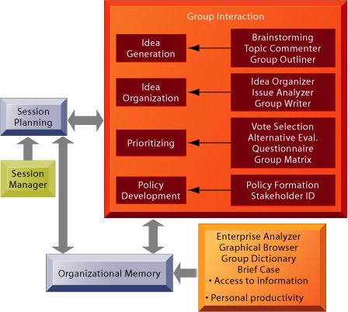
FIGURE 13-7 Group system tools
The sequence of activities and collaborative support tools used in an electronic meeting system facilitate communication among attendees and generate a full record of the meeting.
Sources: From Nunamaker et al., “Electronic Meeting Systems to Support Group Work,” Communications of the ACM, July 1991. Reprinted by permission.

Slide 89
GDSS software
Using GDSS software, studies show the number of attendees at a meeting can increase while productivity also increases.
One reason for this is that attendees contribute simultaneously rather than one at a time.
A GDSS contributes to a more collaborative atmosphere by guaranteeing contributors’ anonymity so that attendees focus on evaluating the ideas themselves.
If properly designed and supported, GDSS meetings increase the number of ideas generated and the quality of decisions while producing the desired results in fewer meetings in both face-to-face and distributed meeting environments.
The nature of electronic meeting technology is only one of a number of factors that affect meeting processes and output.
The outcome of group meetings depends on the composition of the group, the manner in which the problem is presented to the group, the facilitator’s effectiveness, the organization’s culture and environment, the quality of the planning, the cooperation of the attendees, and the appropriateness of tools selected for different types of meetings and decision problems

Slide 90
Executive Support in the Enterprise
Contemporary ESS bring together data from all parts of the firm and enable managers to select, access, and tailor them as needed using easy-to-use desktop analytical tools and online data displays.
Through their ESS, many managers have access to public data, such as news services, financial market databases, and economic information.
ESS have the ability to drill down, moving from a piece of summary data to lower and lower levels of detail. The ability to drill down is useful not only to senior executives but also to employees at lower levels of the firm who need to analyze data.
Contemporary ESS include tools for modeling and analysis.
Whereas DSS use such tools primarily for modeling and analysis in a fairly narrow range of decision situations, ESS use them primarily to provide status information about organizational performance.
Well-designed ESS also have some facility for environmental scanning.
A key information requirement of managers at the strategic level is the ability to detect signals of problems in the organizational environment that indicate strategic threats and opportunities.

Slide 91
benefit of ESS
The most visible benefit of ESS is their ability to analyze, compare, and highlight trends.
The easy use of graphics enables the user to look at more data in less time with greater clarity and insight than paper-based systems provide.
The timeliness and availability of the data result in needed actions being identified and carried out earlier than previously could have been done.
Problems are handled before they become too damaging; opportunities are also identified earlier.
Immediate access to so much data also enables executives to better monitor activities of lower units reporting to them.
That very monitoring ability enables decision making to be decentralized and to take place at lower operating levels.

Slide 92
benefit of ESS
Today, customer expectations, Internet technology, and new business models alter the competitive landscape so rapidly that managers need special capabilities for competitive intelligence gathering.
ESS help managers identify changing market conditions, formulate responses, track implementation efforts, and learn from feedback.
ESS are configured to summarize and report on key performance indicators for senior management in the form of a digital dashboard or “executive dashboard.”
The dashboard displays on a single screen all of the critical measurements for piloting a company, similar to the cockpit of an airplane or an automobile dashboard.

Slide 93
benefit of ESS
Companies have traditionally measured value using financial metrics, such as return on investment (ROI).
Many firms are now implementing a balanced scorecard model that supplements traditional financial measures with measurements from additional perspectives, such as customers, internal business processes, and learning and growth.
Managers use balanced scorecard systems to see how well the firm is meeting its strategic goals.
Companies use these new enterprise-reporting capabilities to create measures of firm performance that were not previously available, including activity-based costing.
Activity-based costing is a budgeting and analysis model that identifies all the resources, processes, and costs, including overhead and operating expenses, required to produce a specific product or service.
It enables managers to ascertain which products or services—or customers—are profitable and those that are not profitable so they can determine the changes required to maximize firm profitability.

Slide 94
Management Opportunities, Challenges, and Decisions
Systems for decision support provide extraordinary opportunities for increasing the precision, accuracy, and rapidity of decisions made by both managers and employees.
Systems to support decision making raise the following challenges: building systems that can actually fulfill executive information requirements; changing management thinking to make better use of systems for decision support; and organizational resistance.
The information requirements for a DSS or ESS are more unstructured and fluid and require a much greater level of user participation to develop. Users must work with information systems specialists to identify a problem and a specific set of capabilities that will help them arrive at decisions about the problem. The system must be flexible, easy to use, and capable of supporting alternative decision options.
Several studies have noted that user training, involvement, and experience; top management support; and length of use are the most important factors in the success of management support systems.

